Slide 1

Digital Portfolio
STUDENT NAME: Praveen Kumar.A
REGISTER NO : 2428c0343
NMID : FB179885C2F56D6BCCF496A31BDA4863
DEPARTMENT: B.SC(Artificial Intelligence and Machine Learning)
COLLEGE: Hindusthan College of science and commerce,Erode
Bharathiyar University, Coimbatore.
1
Notes:
1

Slide 2

STUDENT DIGITAL PORTFOLIO USING
FRONT AND DEVELOPMENT
PROJECT TITLE
2

Slide 3




AGENDA
Problem Statement
Project Overview
End Users
Tools and Technologies
Portfolio design and Layout
Features and Functionality
Results and Screenshots
Conclusion
Github Link
3/21/2024 Annual Review
3

Slide 4

PROBLEM STATEMENT
In today’s digital age, students require a professional platform to showcase their academic achievements, skills, projects, and extracurricular activities. Traditional resumes and paper-based portfolios often fall short, as they are less accessible, lack interactivity, and fail to highlight technical abilities effectively. Therefore, there is a growing need for a digital portfolio system that enables students to present their personal details, educational background, skills, projects, certifications, and contact information in an engaging, visually appealing, and interactive format.
4

Slide 5

PROJECT OVERVIEW
A Student Digital Portfolio is a personalized website designed to highlight a student’s biodata, academic background, skills, projects, and accomplishments. It is developed using front-end web technologies like HTML, CSS, and JavaScript. This project not only allows students to present themselves in a professional manner but also helps them enhance their front-end development skills while building an online presence valuable for career opportunities, internships, and higher education.
5

Slide 6

WHO ARE THE END USERS?
Teachers/Professors – to assess a student’s skills, projects, and overall learning progress.
Recruiters/Employers – to examine the student’s qualifications, technical expertise, and previous projects for internships or job opportunities.
College/Placement Cell – to highlight the student’s profile for academic evaluation or placement purposes.
6

Slide 7

TOOLS AND TECHNIQUES
HTML – Used to structure the portfolio with elements such as headings, paragraphs, lists, tables, and images. Example: sections for biodata, project details, and an education timeline.
CSS – Applied to style the portfolio, including colors, fonts, layouts, and responsive design. Styling methods: Internal CSS (within the <style> tag), External CSS (via a separate .css file), and Inline CSS (within HTML tags).
JavaScript – Adds interactivity through features like form validation, animations, and dark mode toggles. Example: validating a contact form or adding navigation bar effects.
Front-End Frameworks (Optional) – Tools such as Bootstrap or Tailwind CSS can be used for responsive layouts, while React.js (advanced option) can be implemented for creating dynamic portfolio websites.
Development Tools – Code editors like CodePen and hosting platforms such as GitHub Pages are used for development and deployment.
7

Slide 8
PORTFOLIO DESIGN AND LAYOUT
Modern design featuring rounded cards, subtle shadows, and blue accents.
Well-structured sections including About, Skills, Projects, Education, and Contact, with smooth navigation through a top navbar.
Completely responsive layout that adapts seamlessly to both mobile and desktop devices.
8

Slide 9
FEATURES AND FUNCTIONALITY
Personal Information Section – Includes name, profile photo, and contact details such as email, phone, LinkedIn, and GitHub.
Education Details – Covers academic qualifications like school, college, degree, and year of study, along with achievements and certifications.
Skills Showcase – Highlights programming languages (HTML, CSS, JavaScript, etc.) and technical skills such as web development, databases, and frameworks.
Projects Section – Displays a list of projects with descriptions, technologies used, and screenshots.
Achievements & Certificates – Features accomplishments from hackathons, workshops, and online courses.
Portfolio Gallery – Contains images or videos of work such as designs, websites, and applications.
Languages Known – Useful for multilingual students (e.g., Tamil, English, Hindi).
Interactive Navigation – Offers a sticky navbar with smooth scrolling and section highlighting as the user navigates.
Animations & Effects – Implements fade-in and slide animations using CSS or JavaScript.
Search/Filter in Projects – Allows users to filter projects by category (e.g., Web, Java, Python).
Social Media Integration – Provides icons linking to LinkedIn, GitHub, Instagram, and other platforms.

Slide 10
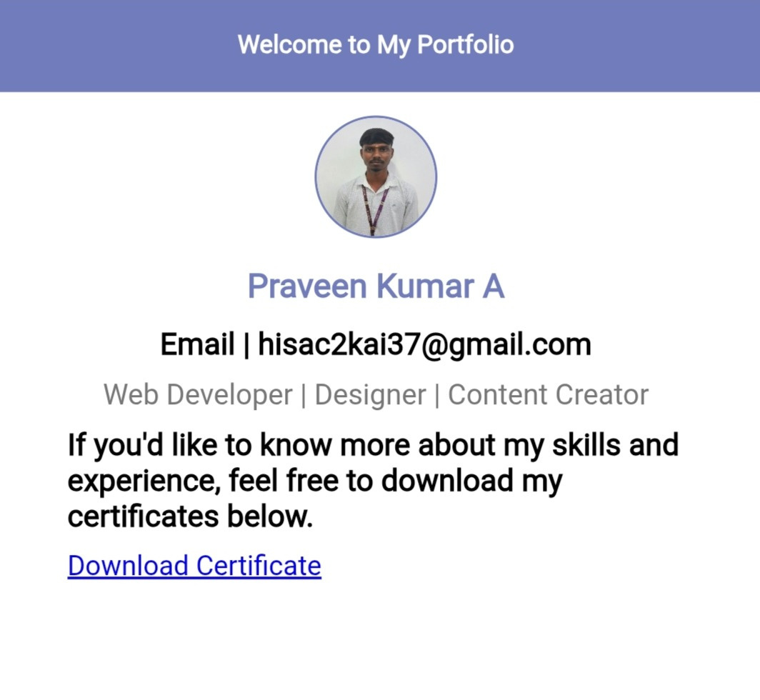

RESULTS AND SCREENSHOTS
3/21/2024 Annual Review
10

Slide 11
CONCLUSION
Building this digital portfolio has been a valuable experience in presenting my skills and progress as a student in front-end development and software projects. By designing and developing interactive web pages and applications, I have gained hands-on knowledge of HTML, CSS, JavaScript, and project management. This portfolio not only showcases my technical expertise but also reflects my creativity, problem-solving abilities, and passion for continuous learning. Each project represents growth in areas such as user interface design, responsive layouts, and functional programming. Looking ahead, I plan to strengthen my skills further by working with advanced frameworks and real-world projects. This portfolio stands as both a strong foundation for my career in web development and a testament to my commitment to improvement and innovation.
11

